Slide 1
PlaNXT: Event 360
Mu-Ruei Tseng & Louis Ruffino

Slide 2
Introduction
What is PlaNXT:
A Venue Floor Planning application designed to enhance the event planning process, offering a streamlined and user-friendly experience
Comprehensive pipeline that guides users from the initial creation of an event to adding steps and design layout for the venue
Introducing a novel time-lapse function for visualizing the event’s progression and their corresponding layouts in 3D
Our End Users:
Event Organizers who seek to meticulously plan and visualize every aspect of their events
Notes:
PlaNXT is an innovative Venue Floor Planning application thats designed to enhance the event planning process, offering a streamlined and user-friendly experience.
It features a comprehensive pipeline that guides users from the initial creation of an event through various stages, including detailed layout design for the venue.
A unique time-lapse feature allows planners to visualize the event's progression and corresponding layouts in a dynamic 3D format, providing a real-time perspective of spatial arrangements at different stages.
This is a legacy project; however due to the poorly design database, unorganized app structure, and various functionality bugs, we decided to refactor the whole app to better suit our development of integrating 3D visualization with the 2D planning page

Slide 3
Introduction
What is PlaNXT:
A floor planning application that simplifies the planning process
Comprehensive pipeline that guides users from the initial creation of an event to adding steps and design layout for the venue
Novel time-lapse function for visualizing the event’s progression and their corresponding layouts in 3D
End Users:
Event Organizers who seek to meticulously plan and visualize every aspect of their events
Notes:
PlaNXT is an innovative Venue Floor Planning application thats designed to enhance the event planning process, offering a streamlined and user-friendly experience.
It features a comprehensive pipeline that guides users from the initial creation of an event through various stages, including detailed layout design for the venue.
A unique time-lapse feature allows planners to visualize the event's progression and corresponding layouts in a dynamic 3D format, providing a real-time perspective of spatial arrangements at different stages.
This is a legacy project; however due to the poorly design database, unorganized app structure, and various functionality bugs, we decided to refactor the whole app to better suit our development of integrating 3D visualization with the 2D planning page

Slide 4
Application Flow
Workflow for PlaNXT
User Registration and Login
Plan Dashboard
Plan Creation
Updating Plan Details
Planning in 2D
3D Layout Visualization

Slide 5
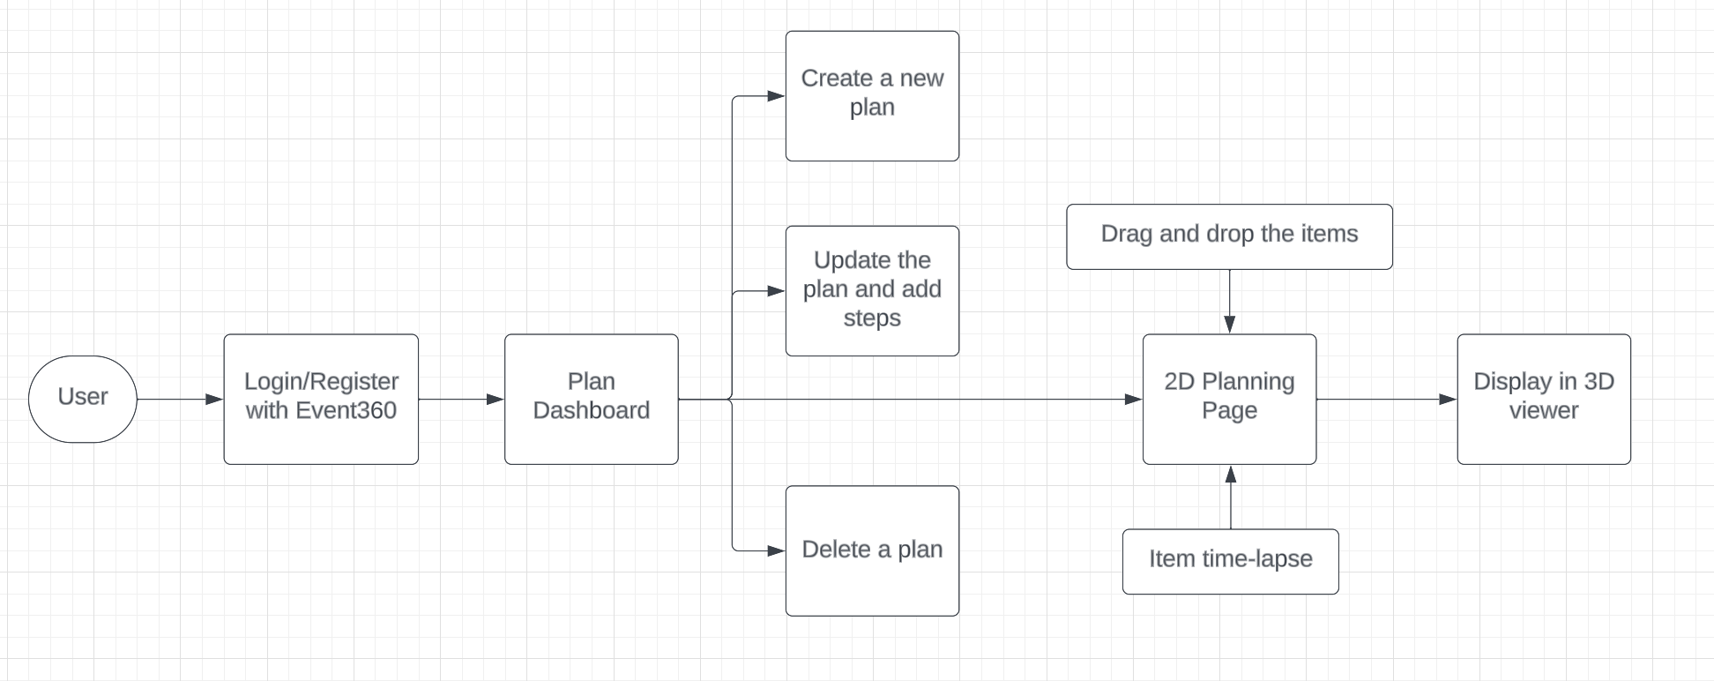
Application Flow

Slide 6
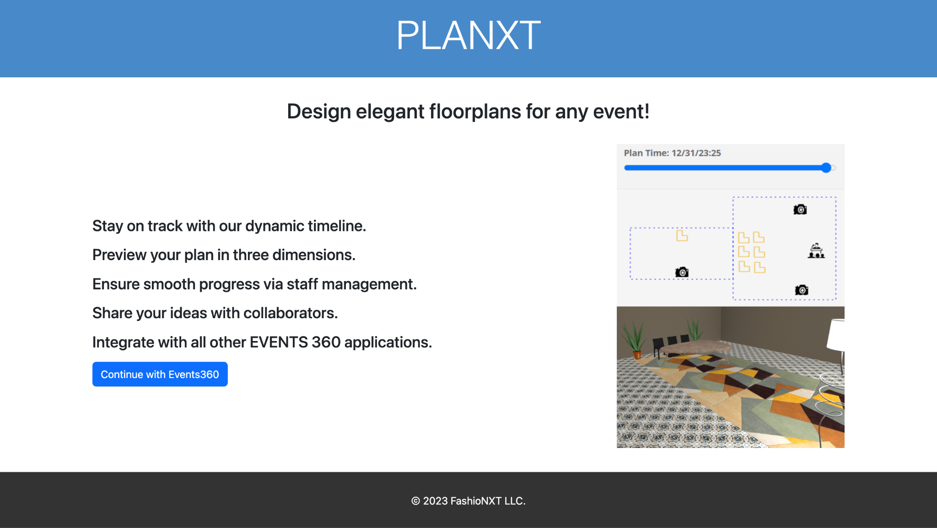
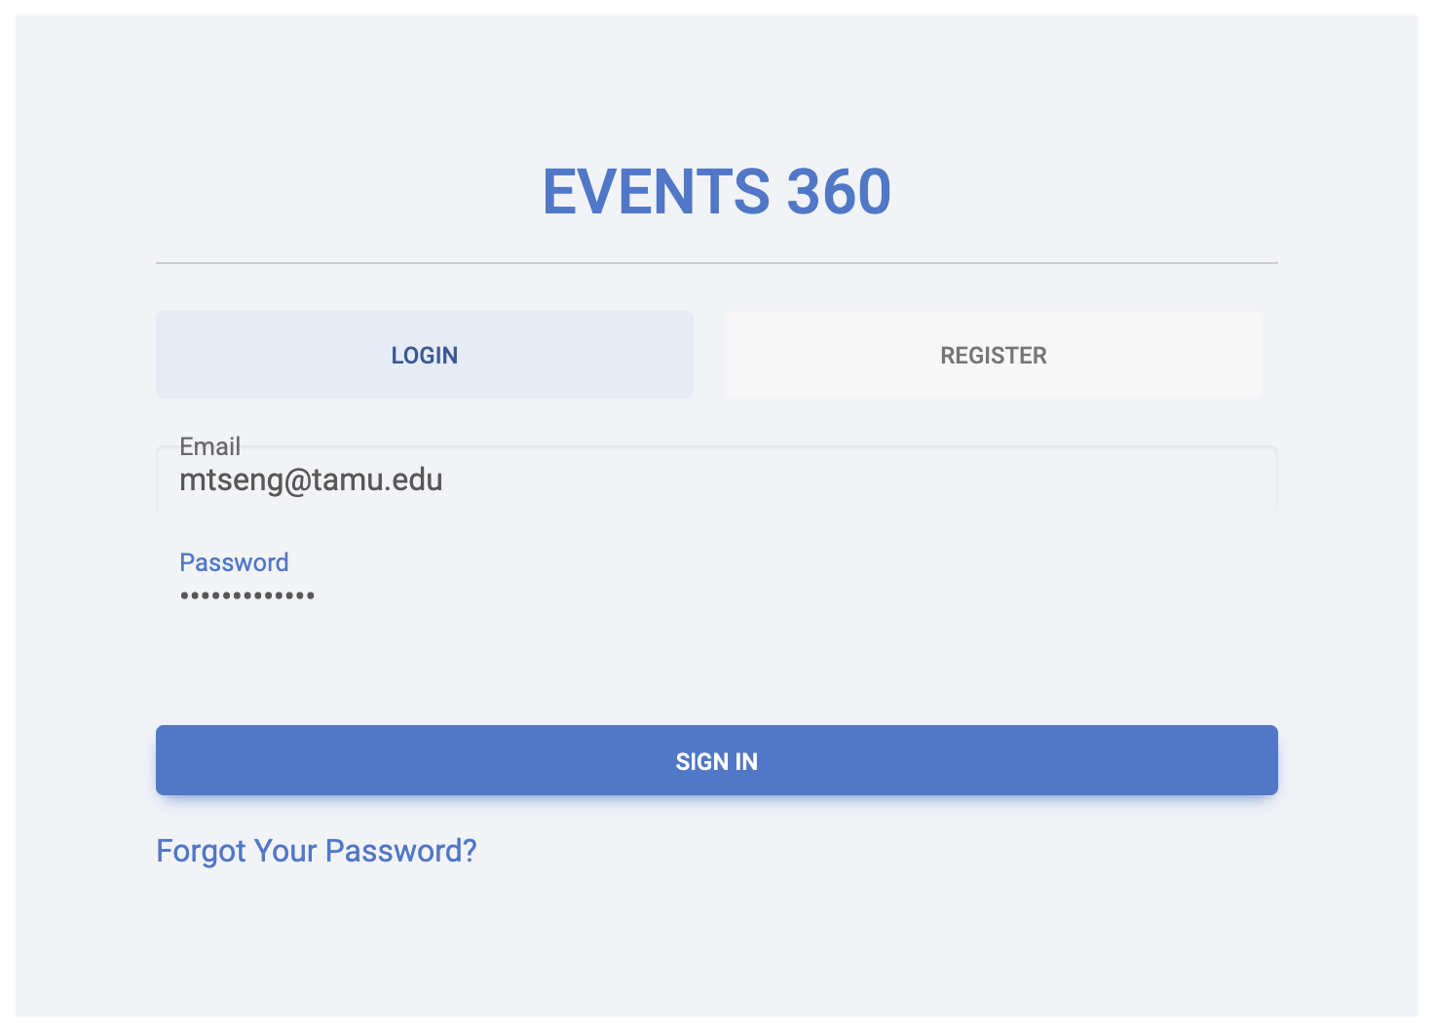
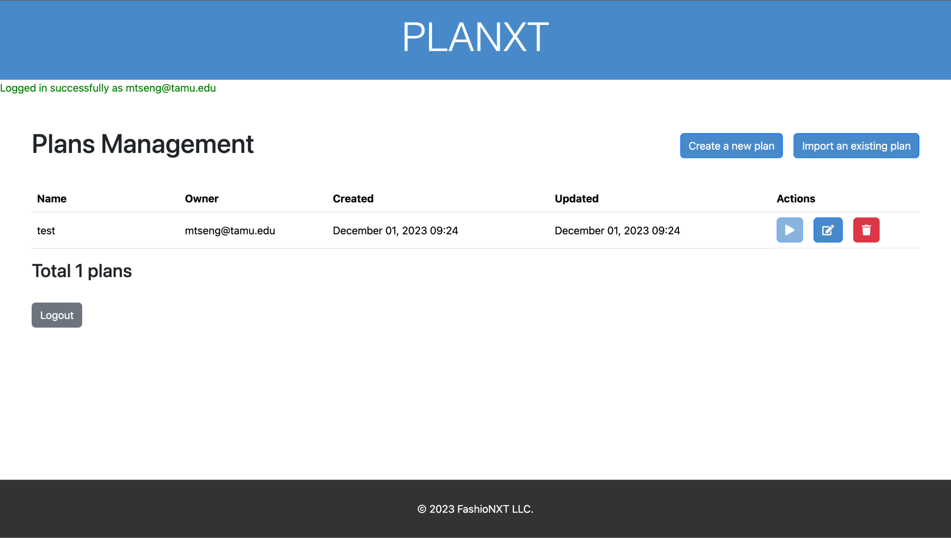
User Registration/Login
Seamless integration with the Event360 CRM system
Secure registration and login process for new and returning users
Required login to see the plans and only the plans that the user created

Slide 7
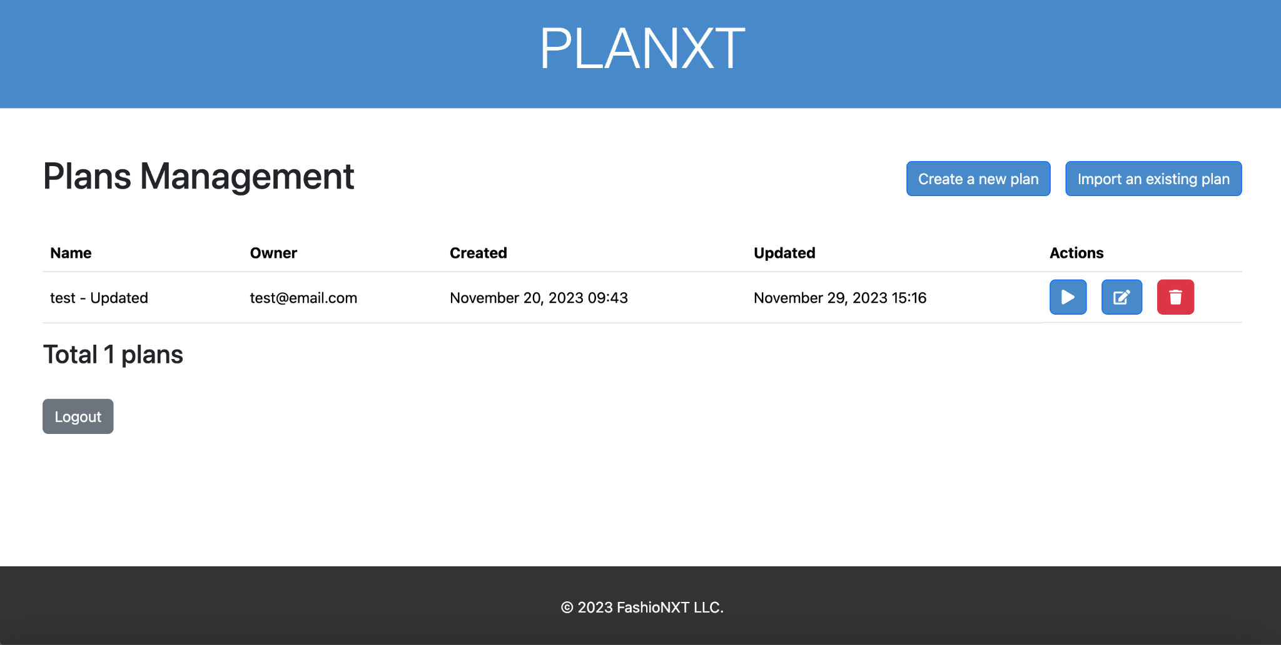
Plan Dashboard
Viewing all the plans that created by the login user
Includes three actions: Play, Edit, and Trash
Play: enter the planning 2D page (disable if no step is added)
Edit: update the plan
Trash: delete the plan
Play
Edit
Trash

Slide 8
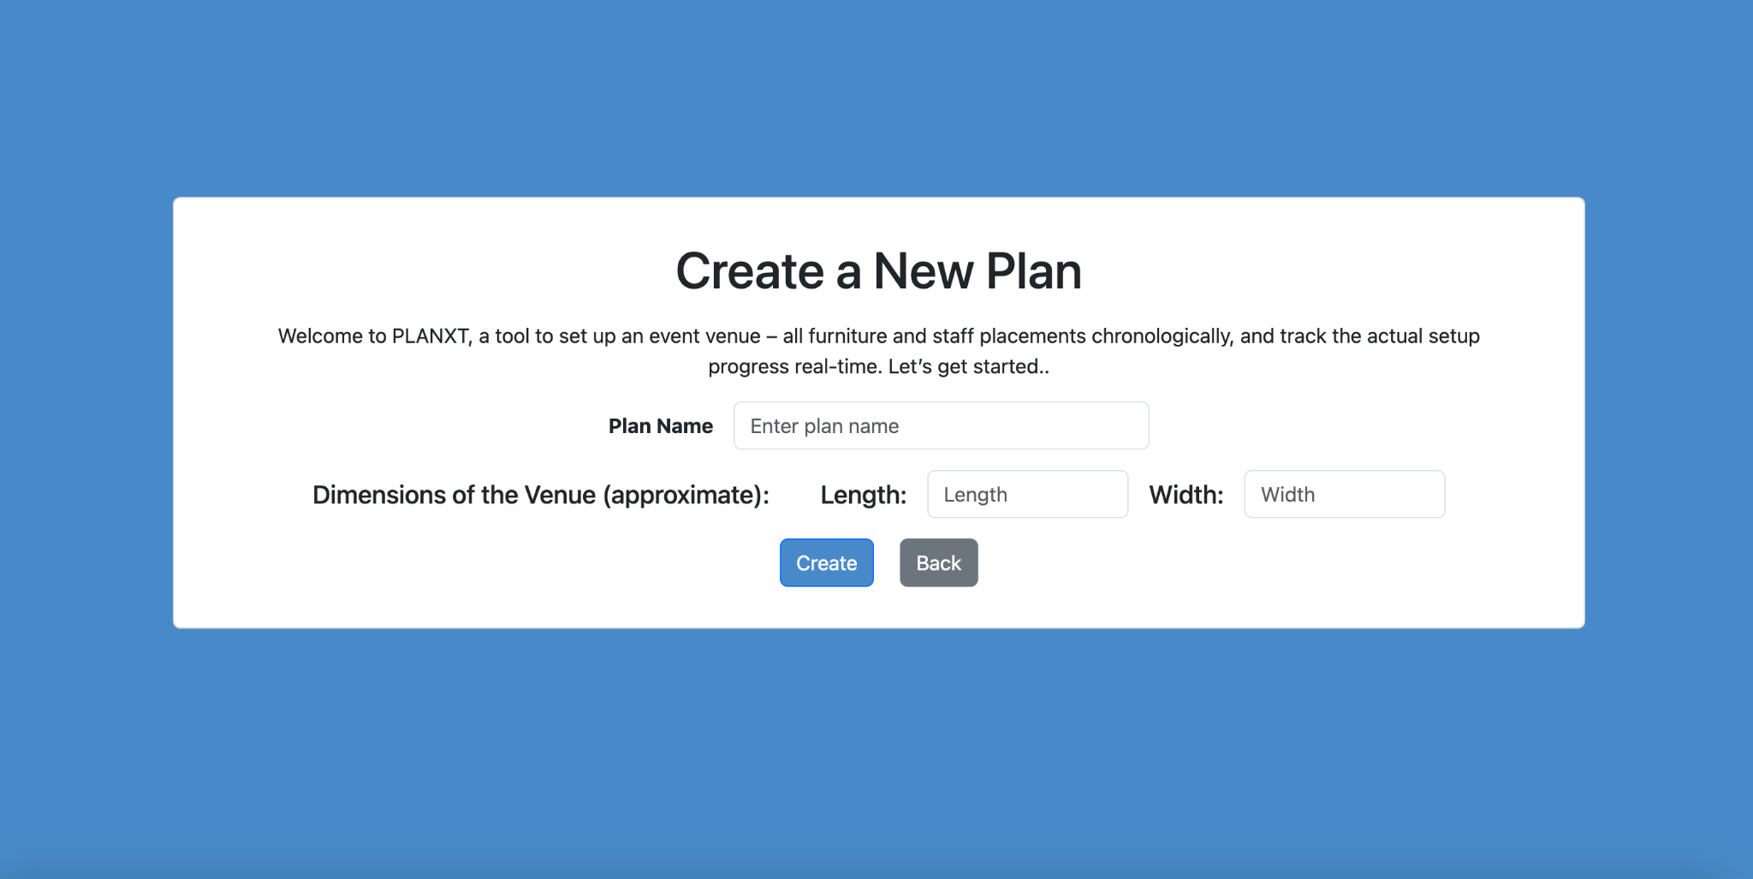
Plan Creation
Create a plan by specifying the name and the venue’s length and width.
Decouple steps creation from plan creation, i.e. we now create the plan first and add the steps during the update plan phase.

Slide 9
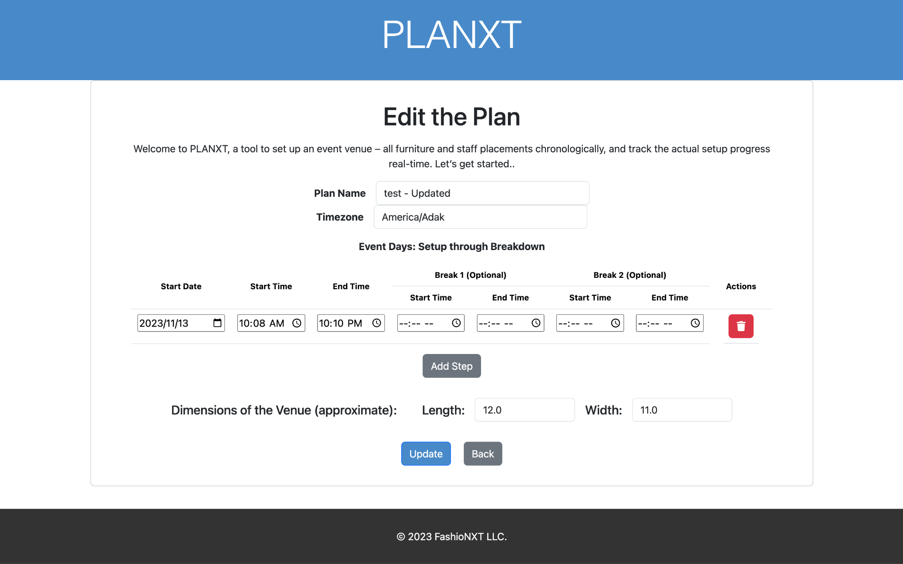
Plan Update
Update the properties of a plan, including its name, venue length/height and timezone
Adding the steps towards a plan, specify with the start date, the start/end time and the break time
A step can be viewed as the date that the plan involves (since a plan for an event can span multiple days)
A plan must have a least one step

Slide 10
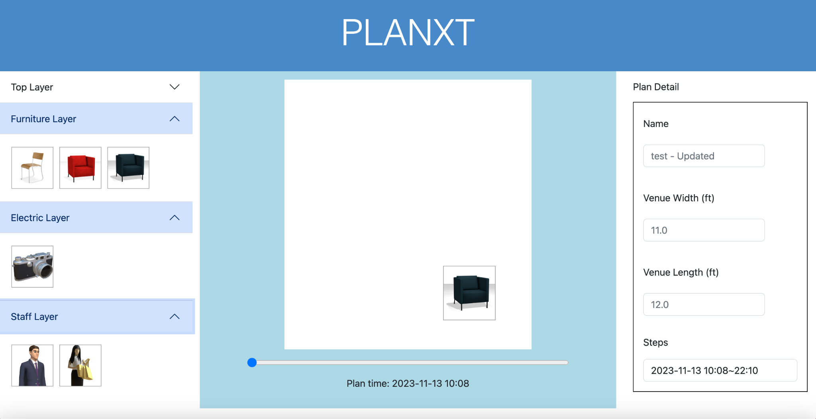
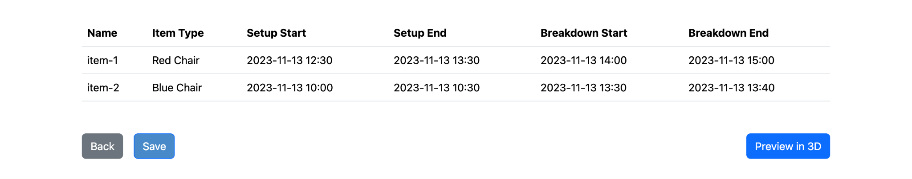
Planning in 2D
This page is specifically designed for crafting detailed 2D floor plans.
Offers intuitive drag-and-drop functionality for seamlessly adding items to the plan.
Features a time-lapse slider to visually represent the chronological placement and movement of items.
Displays a comprehensive table listing all items added to the venue canvas for easy tracking and management.
Notes:
The canvas is resized according to the determined venue width and length
The measurement of the venue is in feets while the items are measured in inch

Slide 11
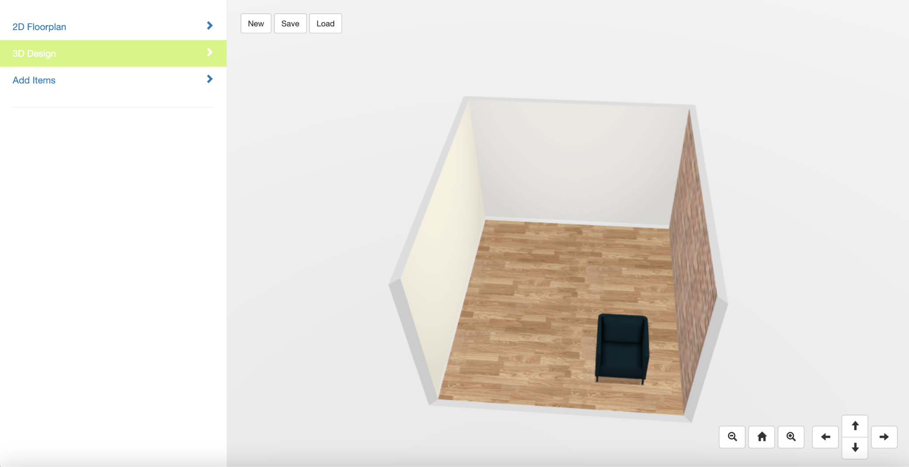
3D Rendering
Enables viewing the layout of items at a specific time within the 3D viewer, offering a comprehensive, three-dimensional perspective of the event space.
Functions similarly to capturing a 3D 'snapshot' of a specific moment in time, as planned and arranged in the 2D planner.
2D Planner
3D Viewer

Slide 12
Key Improvements
Connecting the 3D viewer with our 2D planner
Using assets in the 3D viewer in 2D planner
Refactor the backend code and cleanup the legacy code
Resolving bugs in the 2D planner
Major UI updates to improve user experience
Generally improve upon most of the features present in the legacy application

Slide 13
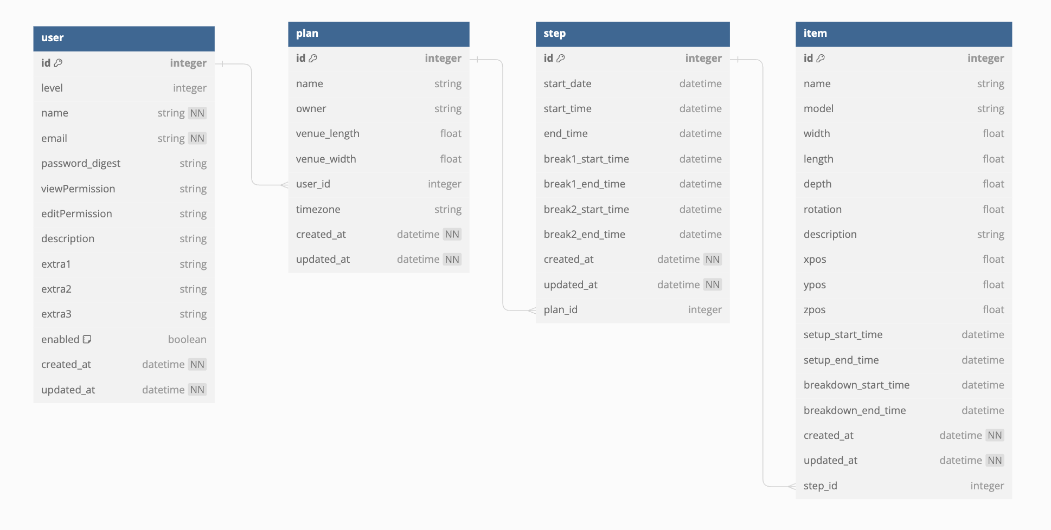
Class Diagram

Slide 14
TDD and BDD
BDD (Cucumber Test with Selenium)
CRUD for the plan
CRUD for adding steps to the plan
Drag-and-Drop an item for planning in 2D
TDD (RSpec) - coverage 93.98%
Unit tests covering all the controllers and models

Slide 15
Difficulties
Legacy Project Issue
Different file structure, naming conventions in various part of the code
Code without proper documentation
Lack of tests in cucumber
Heavy Focus on JavaScript and Three.js
Drag and drop functionality (improve upon previous team’s drag and drop logic)
Perform BDD with cucumber tests that largely involved javascripts
Modify on the 3D viewer repository
Notes:
Modify on the 3D viewer repository is very difficult as it is a third party repository that contains more than 40 thousands lines of code that involved three.js and rendering

Slide 16
Future Development
Smaller Scale:
Adding validation to the planning timeline
Changing 'setup end' and 'breakdown end' to 'duration’
Reflecting rotational changes in the 3D viewer
Adding more assets to the 2D planning page (e.g., those existing in the 3D viewer page)
Adding a layer structure showing the top/bottom relationship between two overlapping items in the 2D planning page
Larger Scale:
Adding a scrollbar to the 3D viewer for enhanced visualization of progression in the 3D view
Enabling editing in the 3D viewer with automatic updates reflected on the 2D planner page
Facilitating the sharing and reuse of existing events among users
Implementing Google OAuth for secure local deployment login
Introducing dependencies between items created in the plan
Check out the project repository for more detailed information: https://github.com/CSCE-606-Event360/Fall2023-PlaNXT

Slide 17
The End!

